Slide 1

BITCOIN PRICE PREDICTION
Submitted By
MEGHAVANI S

Slide 2
AGENDA
INTRODUCTION
DATA COLLECTION
EXPLORATORY DATA ANALYSIS
CONCLUSION
MODEL SELECTION
DATA PREPROCESSING & FEATURE ENGINEERING

Slide 3
INTRODUCTION:
Bitcoin is a decentralized digital currency known for its high volatility and limited supply (max 21 million coins). It operates on a public blockchain without central authority.
Bitcoin’s price is highly volatile and influenced by global events.
Accurate predictions help investors, traders, and financial analysts manage risk and strategy.
PROJECT OBJECTIVE:
Develop a robust forecasting model to accurately predict Bitcoin prices based on historical data. By utilizing this model, the company aims to improve trading strategies, manage risk more effectively, and maximize returns on crypto currency investments.

Slide 4
DATA COLLECTION:
SHAPE :
( 3566, 7 )
Numerical:
7 Columns
No Null Data
Categorical:
0 Columns

Slide 5
FEATURES :
DATE : The date of the recorded Bitcoin price data.
OPEN : The opening price of Bitcoin for that day.
HIGH : The highest price Bitcoin reached during that day.
LOW : The lowest price Bitcoin reached during that day.
CLOSE ( Target) : The closing price of Bitcoin for that day.
ADJ CLOSE : The adjusted closing price, which accounts for any corporate actions like stock splits or dividends. For cryptocurrencies like Bitcoin, this is typically the same as the closing price.
VOLUME : The total number of Bitcoin units traded during that day.

Slide 6

Exploratory Data Analysis

Slide 7
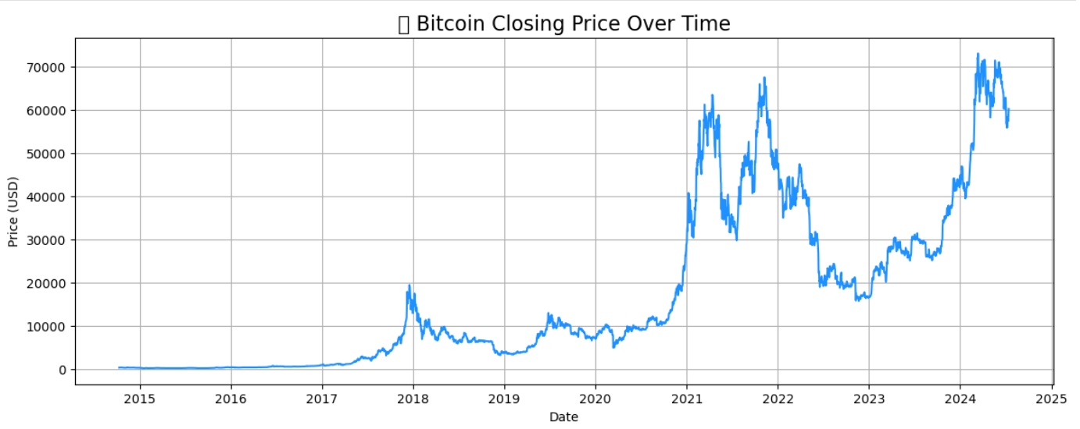
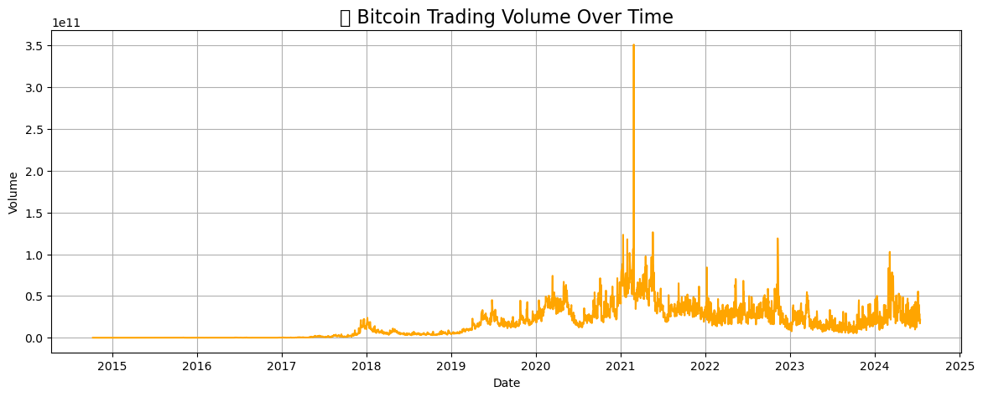
Univariate Analysis:

Slide 8
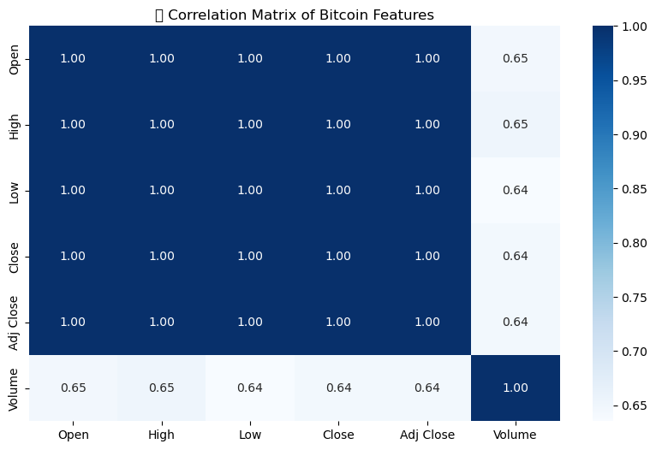
Correlation Heatmap:

Slide 9
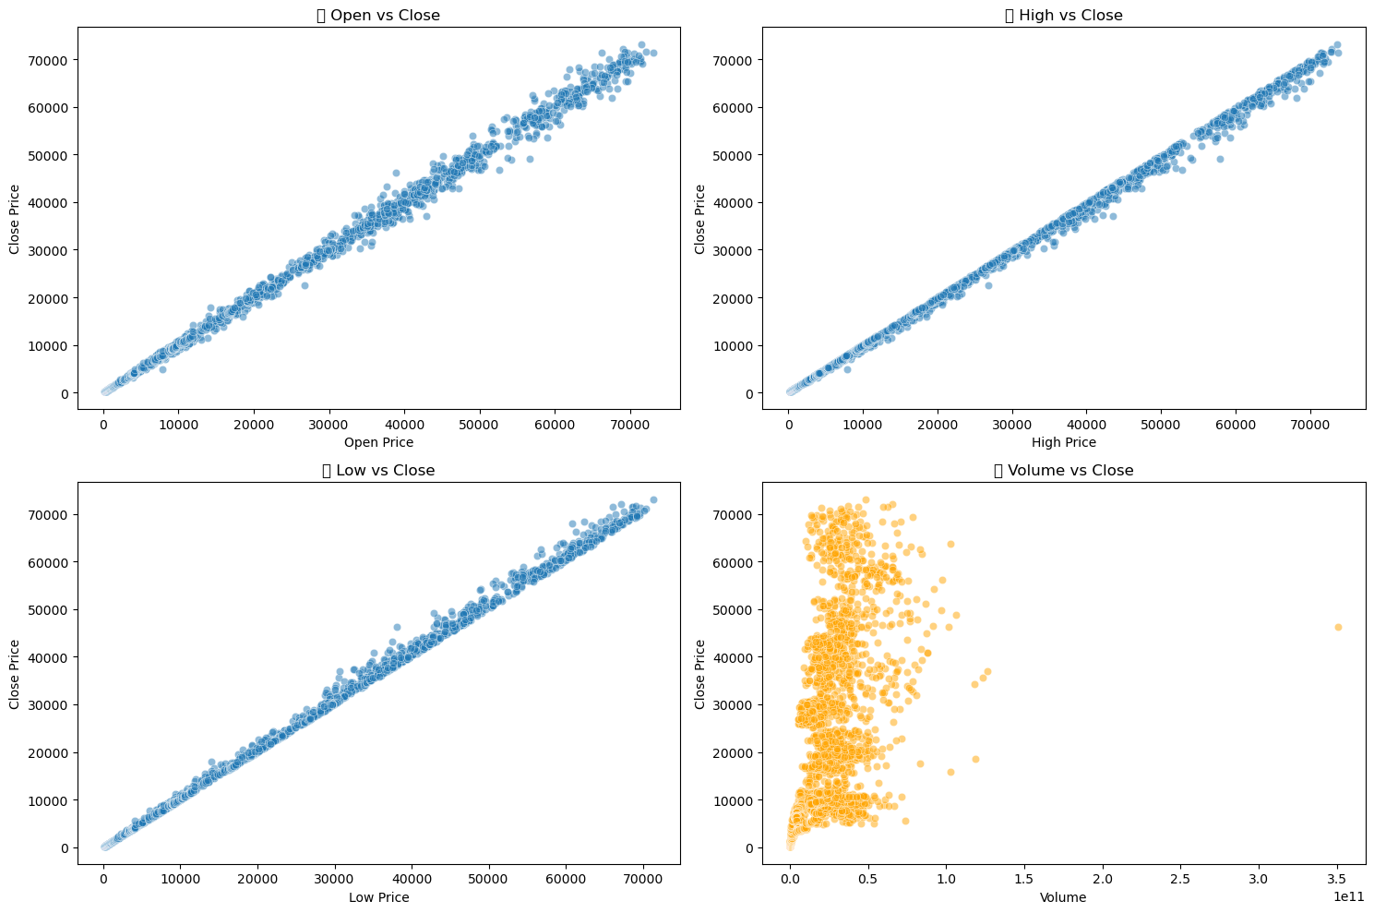
Scatter Plot Exploration:

Slide 10


Slide 11
Overview:
Before applying machine learning or time series models to Bitcoin price data, it was essential to preprocess and enrich the raw dataset. These steps help ensure model accuracy, robustness, and generalization ability. The goal was to capture meaningful patterns, trends, and seasonality using time-aware and volume-related features. This involves:
Handling missing values
Engineering informative features
Transforming the data to suit time-series and machine learning models

Slide 12
Handling Missing Values:
We checked for any null or missing entries in the dataset and handled them to ensure model stability.
Creating Predictive Variables:
We enhanced the dataset with new features that capture historical behavior and seasonality of Bitcoin prices:
Lag Features: Previous values of the close price to capture momentum.
Rolling Statistics: Smoothed averages and volatility.
Daily Returns: Relative changes, useful for identifying sharp moves.
Volume Changes: Useful for identifying trading activity surges.
Date Parts: Extracted time-related components (e.g., month, weekday) to capture cyclical effects.

Slide 13
Lag Features:
Features Created: Close_Lag1 - Price one day before
Close_Lag7- Price seven days before
Captured short-term memory of Bitcoin price trends. Lag features were particularly useful for time-aware models like SARIMA and XGBoost.
Rolling Statistics:
Features Created: Rolling_Mean_7
Rolling_Std_7
Rolling_Mean_30
Captured short- and mid-term trends (momentum) and volatility patterns, crucial in financial time series. Improved the ability of models to adapt to smoothed trends and market uncertainty, particularly benefiting SARIMA and XGBoost.

Slide 14
Daily Return:
Feature Created: Daily_Return - % price change from previous day.
Highlighted recent momentum or trend reversals—signals often used by traders. Improved model responsiveness to rapid market shifts. Enhanced the XGBoost model's generalization.
Volume Change:
Feature Created: Volume_Change - % change in trading volume.
Identified price-impacting spikes or drops in trading activity.
Served as an early indicator of volatility, helping models predict sudden price movements.
Time-Based Features:
Features Created: Day, Month, Year, DayOfWeek
Extracted periodicity and potential calendar-based seasonality (like weekend dips or monthly trends). Useful for capturing non-price-based temporal patterns, which supported XGBoost and SARIMA in identifying seasonal price behaviors.

Slide 15
Feature Engineering Visualization:
To better understand the newly engineered features, we will create visualizations to explore:
Rolling averages and their smoothing effect on the volatile Close prices.
Daily return behavior to observe spikes and drops in percentage changes.
Volume change patterns that might indicate abnormal trading behavior.
Relationships between lagged features and current Close price.

Slide 16
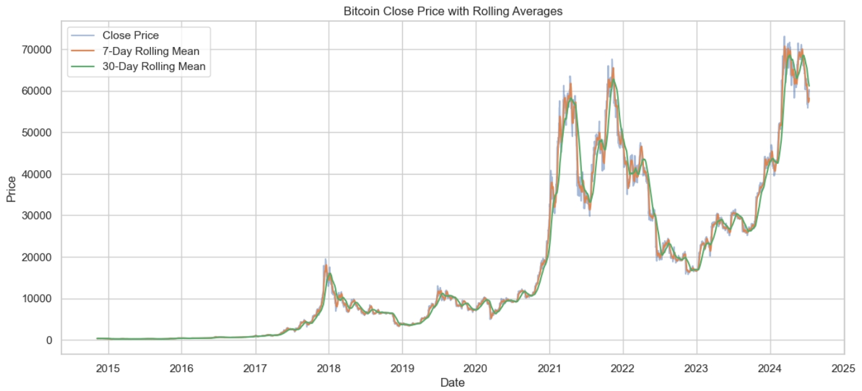
Rolling Mean (7-day and 30-day) vs Close :
The close price is highly volatile with sharp peaks and dips.
The 7-day moving average responds quickly to short-term fluctuations, whereas the 30-day average smoothens out longer trends.
Rolling averages help in identifying trend direction, price momentum, and potential reversal signals—critical for model features in time series forecasting.
Notably, the 30-day moving average lags behind but offers better trend stability, while the 7-day can help capture short-term momentum changes.

Slide 17
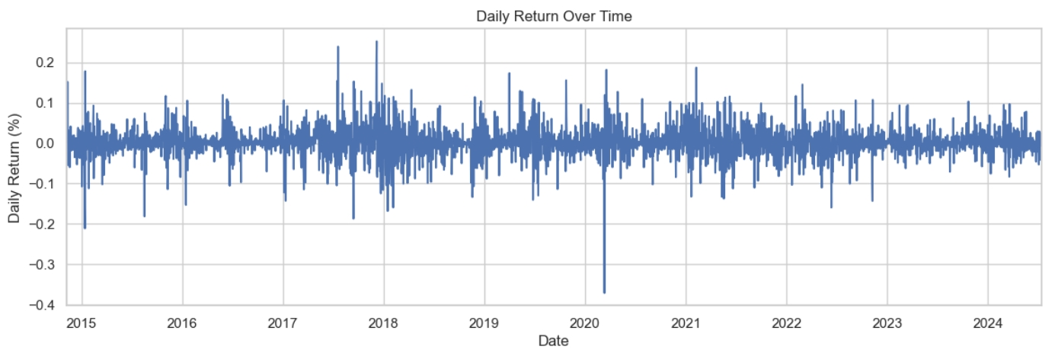
Daily Return Plot:
The majority of returns hover around 0%, with occasional extreme spikes in both directions.
There are frequent negative returns, indicating sudden downward movements.
Some periods (like early 2020) show exceptionally high volatility—possibly due to market shocks or economic events.

Slide 18
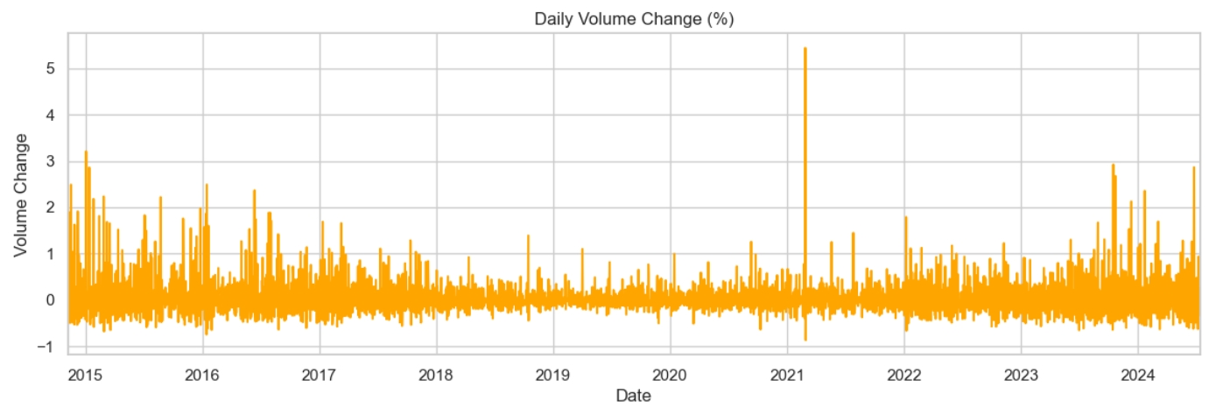
Volume Change Plot:
Most volume changes are relatively small, but periodic spikes indicate high market activity or speculative interest.
Large volume increases often precede or accompany large price changes, reflecting shifts in investor sentiment.
Anomalous spikes (e.g., early 2021) suggest abnormal market behavior or external events influencing trading volume.

Slide 19
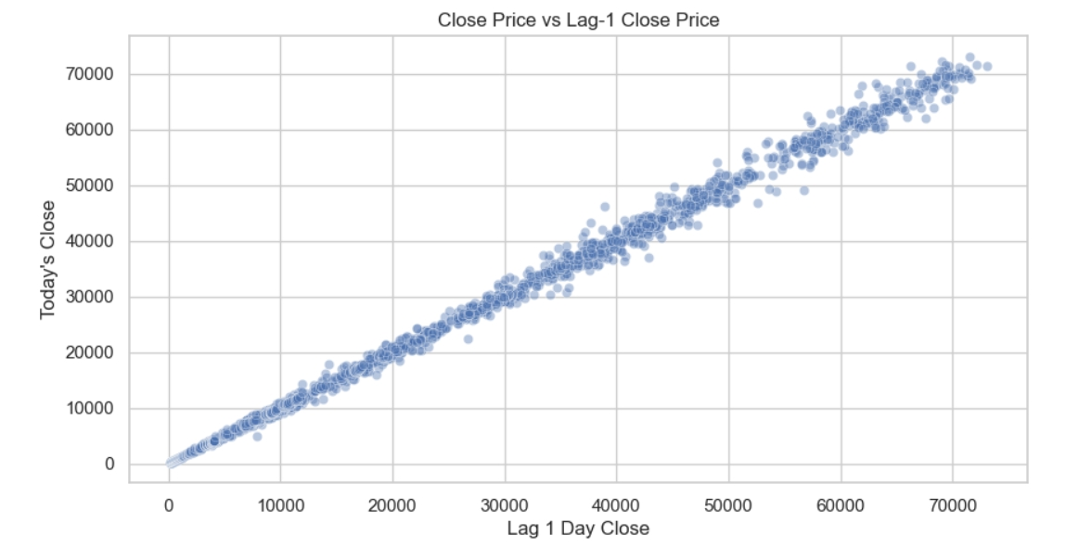
Scatter Plot: Lagged Features vs Close:
The strong linear trend along the diagonal suggests high autocorrelation in Bitcoin's price.
Most points fall very close to a perfect 45-degree line, indicating that today’s price is heavily influenced by the previous day’s price.
This validates the usefulness of lag features (e.g., Lag-1, Lag-7, etc.) in forecasting.

Slide 20
Train-Test Split & Cross-Validation:
To ensure reliable and unbiased model evaluation, we applied both a chronological train-test split and k-fold cross-validation:
Train-Test Split (80/20, Chronological):
Bitcoin is time-dependent — random shuffling would leak future data into the past.
First 80% of the data was used for training.
Final 20% was used strictly for testing, simulating real-world forecasting.
5-Fold Cross-Validation:
To ensure model stability and reduce overfitting.
The training set was further validated using TimeSeriesSplit, preserving temporal order.
Root Mean Squared Error (RMSE) to assess model accuracy.

Slide 21
MODEL SELECTION:
Models Explored:
We evaluated a diverse set of models to forecast Bitcoin prices:
📉 ARIMA – Good for linear time series, lacks seasonality handling.
📆 SARIMA – Captures seasonal effects, but rigid and computationally slow.
🔍 Linear Regression – Simple and interpretable, but underperforms with complex patterns.
🚀 XGBoost – Advanced ML model with high flexibility and feature-based seasonality

Slide 22

MODEL
SELECTION

Slide 23
Model Evaluation Criteria:
We compared models based on:
Root Mean Squared Error (RMSE) – Measures prediction error.
Generalization – How well the model performs on unseen data.
Scalability & Speed – Practicality of training and forecasting.
Handling of Non-Linearity – Ability to capture complex relationships.

Slide 24
MODEL COMPARISON:
Model | Seasonality | Flexibility | RMSE | Verdict
ARIMA | ❌ No | Moderate | >6000 | Not ideal for Bitcoin
SARIMA | ✅ Yes (weekly) | Rigid | 5224.10 | Reasonable baseline
XGBoost (CV) | ✅ via features | High | 4872.08 | Inconsistent accuracy
XGBoost (Test) | ✅ via features | High | 1584.02 | Promising, untuned
XGBoost (Tuned) | ✅ via features | ✅ Very High | 1347.47 | ⭐ Best overall

Slide 25
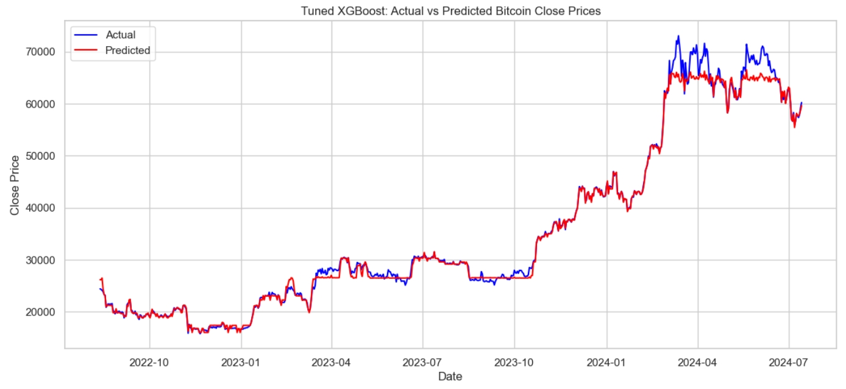
🥇BEST MODEL : XGBoost
The red line (predicted) closely follows the blue line (actual) throughout the test period.
The model successfully captures both trend and seasonality, with less over/underestimation compared to previous models.
Even during volatile periods (early 2024), the predictions are quite stable and realistic.
The Tuned XGBoost model is the final recommended model.
It outperforms SARIMA and untuned ML versions by a large margin in both numerical and visual evaluation.

Slide 26

CONCLUSION

Slide 27
FINAL CONCLUSION:
Bitcoin, the world’s most prominent cryptocurrency, has shown highly volatile and non-linear price behavior, making it a compelling subject for financial forecasting. Accurate prediction of Bitcoin’s closing price is of significant interest to investors, traders, and data scientists aiming to manage risk and maximize returns. This project focuses on building robust forecasting models for Bitcoin using a combination of time-series techniques and machine learning algorithms to identify patterns in historical price and volume data.
To achieve this, we carried out a structured workflow starting with exploratory data analysis (EDA) and visualization to understand trends, seasonality, and anomalies. We then performed comprehensive feature engineering—including lag features, rolling statistics, returns, and volume-based metrics—designed to extract time-dependent patterns. Multiple models were evaluated including traditional time-series models like ARIMA and SARIMA, as well as machine learning models like Linear Regression and XGBoost. Cross-validation with TimeSeriesSplit and time-aware train-test splitting were used to ensure temporal integrity. Finally, hyperparameter tuning was performed on XGBoost, resulting in a significantly lower RMSE.
In conclusion, the tuned XGBoost model emerged as the best-performing model, achieving a Test RMSE of 1347.47, far outperforming other models in both accuracy and generalization. This outcome demonstrates that machine learning models, when paired with rich feature engineering and proper validation, can effectively handle the complexity of cryptocurrency price forecasting.

Slide 28
THANK YOU !

